Slide 1

Speak fluently
Intermediate

Slide 2

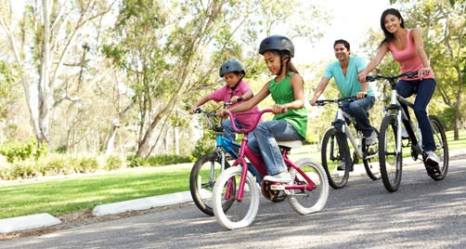
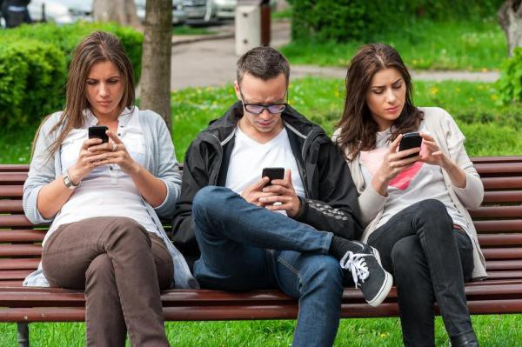
10. Leisure Time

Slide 3
10. Leisure Time
Do you have enough free time? If so, do you usually plan your free time or you just relax? ·
What do you enjoy doing in your free time?
– How often do you hang out with your friends?
– How do you keep in touch with your friends?
How do you like to spend your free time?
going shopping? going to the cinema? chatting? playing computer games going to the disco? playing sports? reading? relaxing?
If you had more free time, what would you do with it?
Do people's leisure time activities change as they get older? How?
Who do you think has more leisure time men or women?
What new activity would you like to try doing in your free time?
Do you ever feel that you waste your free time? How?
What can you do about this?

Slide 4
10. Leisure Time
What do you do in your free time in general?
What is your favorite free time activity?
What do you do in the mornings?
What do you do in the afternoon?
What do you do in the evening?
What do you do on weekend?
What do you do on the internet in your free time?
Do you like spending time on your smart phone in your free time?
Which spare time activities are the most demanding/the most challenging/the easiest/the most expensive/the cheapest/the most enjoyable?

Slide 5
10. Leisure Time
Do you have more free time now than when you were a kid?
Do you find that your works or studies takes up your free time?
Are there any activities that you used to do but don't do anymore? Why did you stop?
Do you think people had more or less free time in the past?
What is the most worthwhile thing a person can do with their free time?
What does the idiom “Time is money.” mean? Do you agree with it?
Is there something you wish you could do with your free time but can’t?
Do you think a four day work week would be a good idea?

Slide 6

10. Leisure Time
Leisure Time Activities
grab some lunch: get lunch
keep in touch over facebook: talk over Facebook
banter: idle, casual conversation
getting all their gossip: learning news about other people
try not to leave it too long: try to talk more regularly
having a proper catch up: spend some time catching up

Slide 7
10. Leisure Time
Vocabulary:
Leisure time = Free time
hanging out with my friends: spending time together
introverted person: like spending time alone, quiet
meet up: hang out
1 to1: talking with just 1 other person, rather than a group
catch up over a coffee: get a coffee and talk about what is new in your life
leisure time activity: something done for pleasure or entertainment during one's free time
Recreation: Enjoying your time and relaxing in your leisure time
Have fun: to enjoy your time and be amused
Engage in/ take part in= to participate in something

Slide 8
10. Leisure Time
Idioms
“know someone through and through” = know very well “Hey, I know him through and through, and I can only say he is full of integrity.”
“true-blue friend” = someone who is completely loyal to another “A true-blue friend never turns against his or her friends.”
“pursue a hobby”= to continue to do it
‘believe it or not’: it is a bit surprising

Slide 9
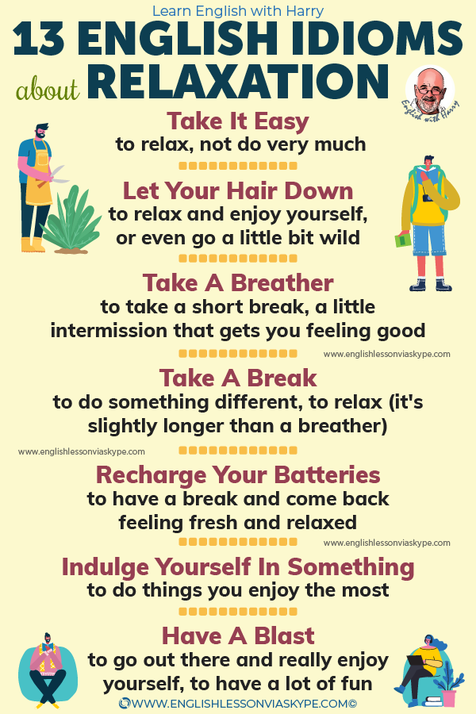

10. Leisure Time

